Slide 1
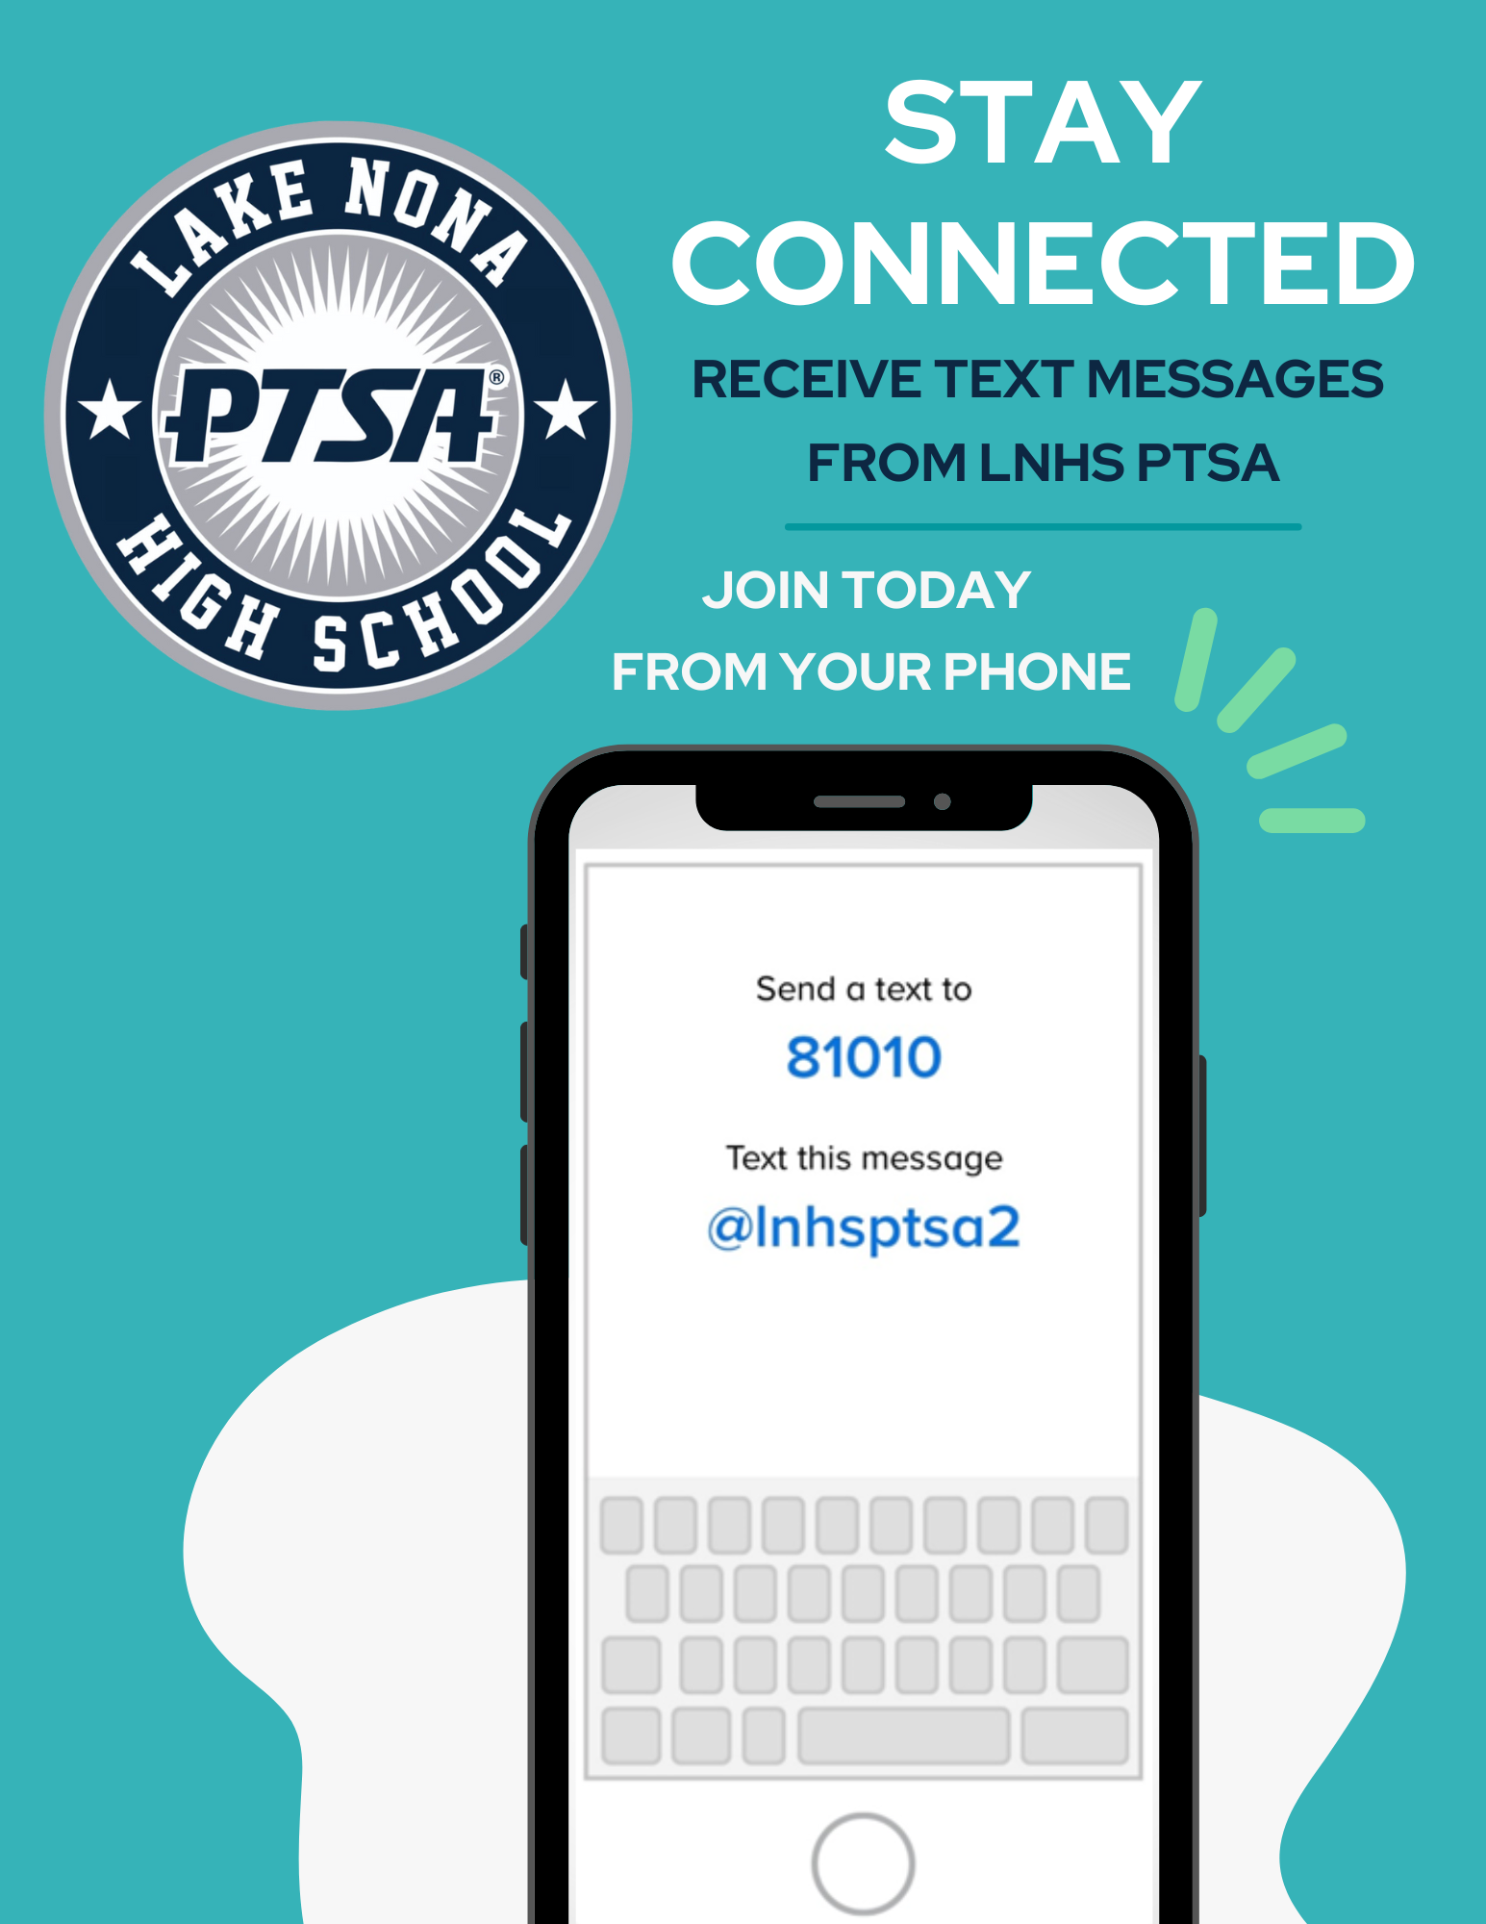


WELCOME
LNHS PTSA
GENERAL MEETING
WEDNESDAY
AUGUST 27, 2025
MEDIA CENTER
81010
@ptsalnhs
www.LNHSPTSA.com

Slide 2
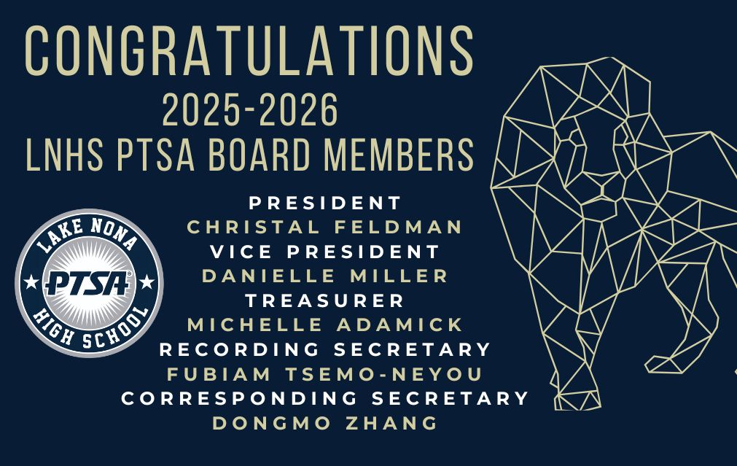

Slide 3
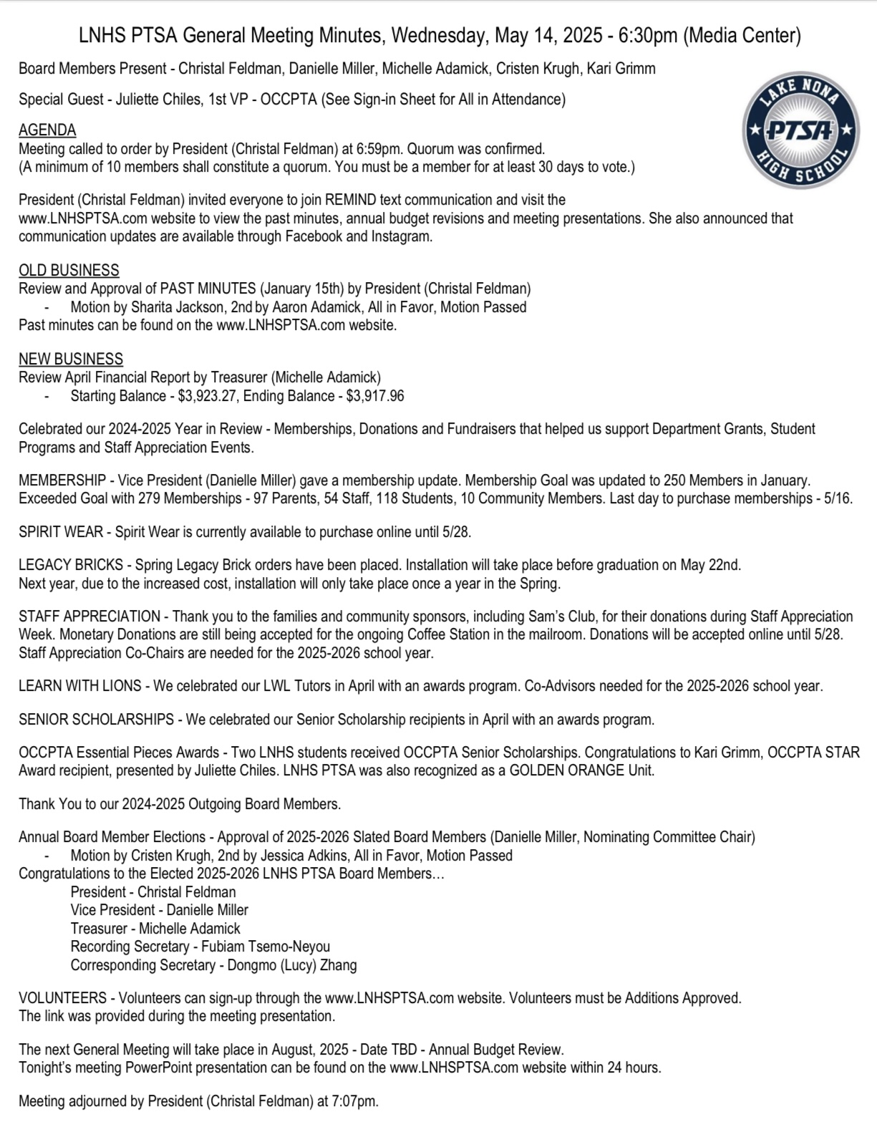

PAST MINUTES
MAY 14, 2025
FOR APPROVAL

Slide 4
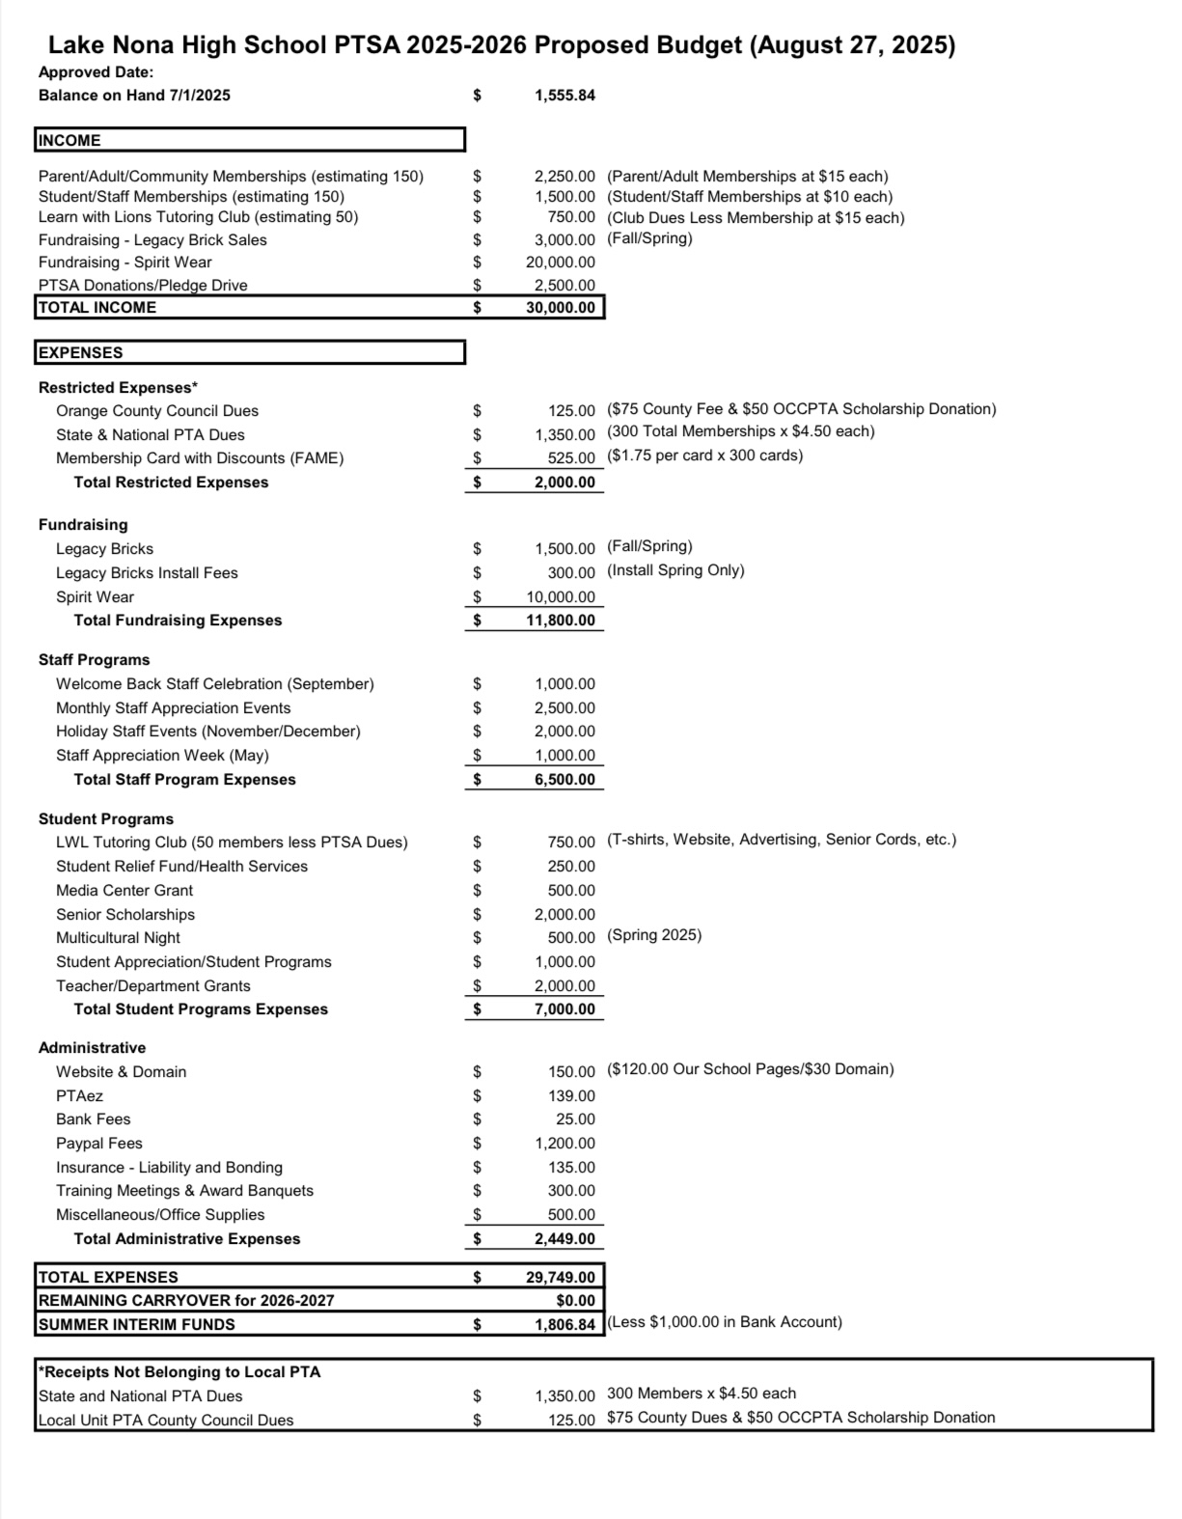
ANNUAL
BUDGET REVIEW
FOR APPROVAL

Slide 5
JULY 2025
FINANCIAL
REPORT
Starting Balance - $1,555.84
Ending Balance - $2,897.43

Slide 6

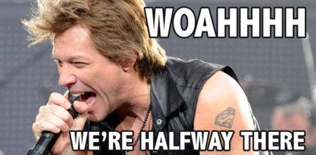
Help Us
Meet Our Goal
of 300 Memberships!
Parents - 68
Staff - 43
Students - 26
Community - 7
142 Memberships
ALMOST

Slide 7

NEW SPIRIT WEAR COMING SOON!

Slide 8

LEGACY
BRICKS
- Now Available to
Purchase Online
- Install Once a Year
in the Spring

Slide 9

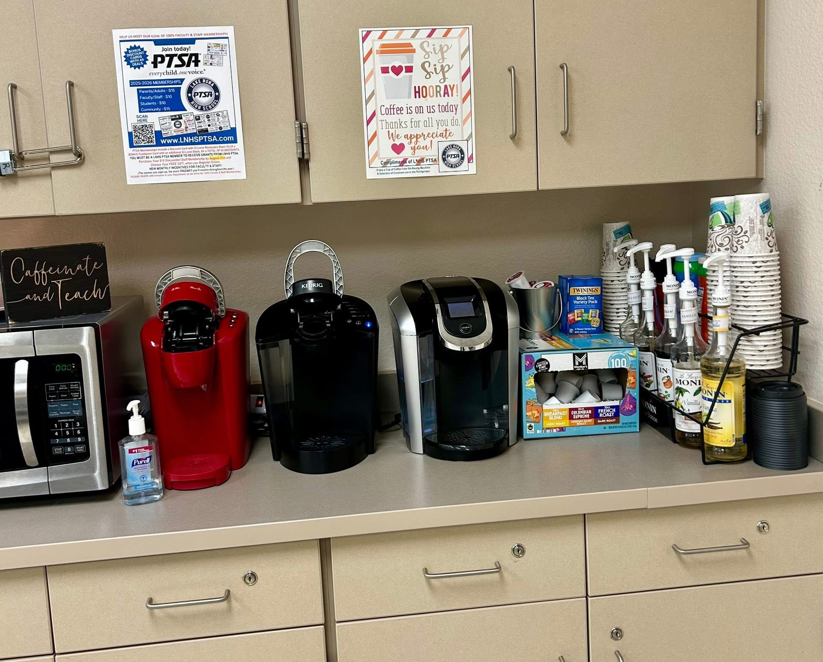
STAFF APPRECIATION
Co-Chairs Needed

Slide 10

LEARN WITH
LIONS
Virtual Tutoring Club

Slide 11


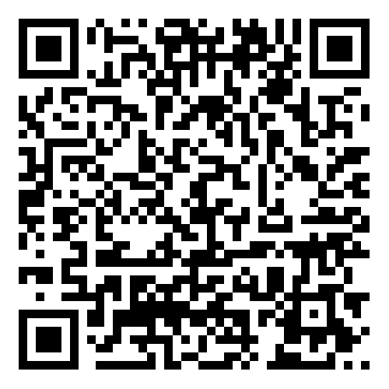

EMAIL - LNHSPTSA@gmail.com
WEBSITE - www.LNHSPTSA.com
Next Meeting - January 2026

